Slide 1
Chapter 1
INTRODUCTION TO ALGORITHMS AND FLOWCHARTS
Introduction to computer science

Slide 2
Chapter 1
Algorithms
Using Flowchart to describe Algorithm
Algorithm in pseudo-code
Branching in Algorithms
Loop in Algorithms

Slide 3
1. Algorithms
An algorithm is defined as a step-by-step sequence of instructions that describes how the data are to be processed to produce the desired outputs.
In essence, an algorithm answers the question: “What method will you use to solve the problem?”.
You can describe an algorithm by using flowchart symbols. By that way, you obtain a flowchart.
Flow chart is an outline of the basic structure or logic of the program.
Another way to describe an algorithm is using pseudocode.

Slide 4
2. Using Flowchart to describe algorithm
Terminal
Input/output
Process
Flowlines
Decision
Connector
Predefined process
Fig 1. Flowchart symbols

Slide 5
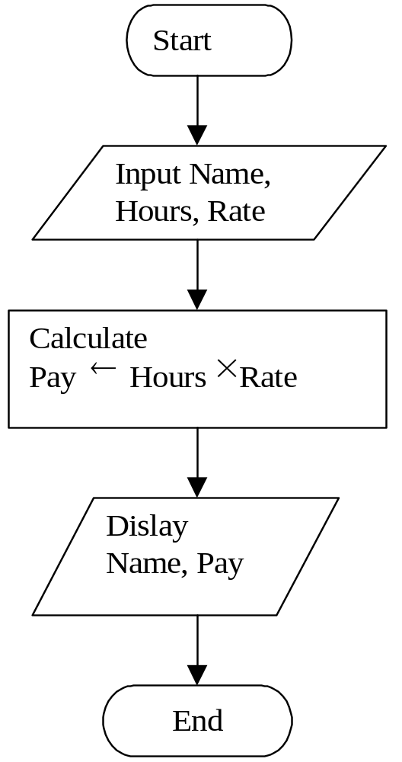
Example 2.1. Calculate the payment of an employee
Fig. 2.
Note: Name, Hours and Pay are variables in the program.

Slide 6
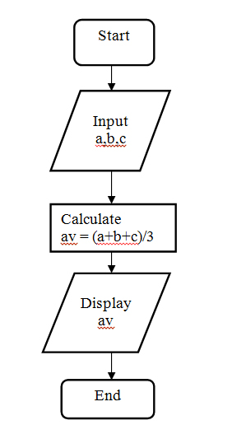
Example 2.2: Calculate the average of 3 numbers
Fig. 3.

Slide 7
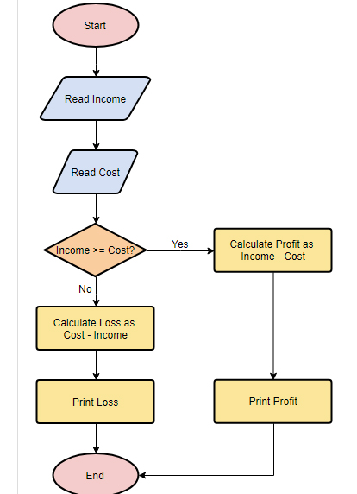
Example 2.3: How to compute profit and loss.
Fig. 4.

Slide 8
3. Algorithms in pseudo-code
You also can use English-like phases to desribe an algorithm. In this case, the description is called pseudocode.
Example: The pseudocode for the program with the flowchart in Fig. 2.
Input the three values into the variables Name, Hours, Rate.
Calculate Pay = Hours × Rate.
Display Name and Pay.

Slide 9
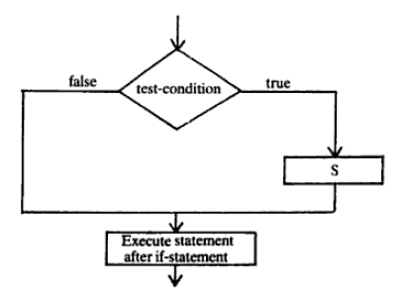
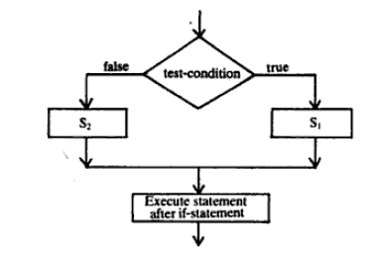
4. Branching in algorithms
If test-condition then S₁
endif
If test-condition then S₁
else S₂
endif

Slide 10
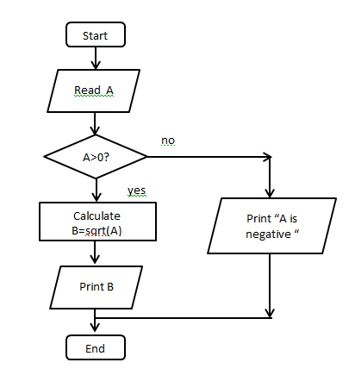
Example 2.1
Pseudo-code of the program:
Input A
if A > 0 then
calculate B = sqrt(A)
print B
else
Print “ A is negative”
endif

Slide 11
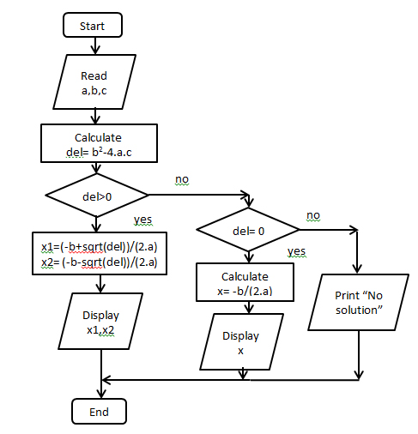
Branching
Example 4.2: Solving the quadratic equation:
ax² + bx +c = 0
Pseudo-code of the program:
Input a, b, c
Calculate del = b2 + 4.a.c
if del >0 then
x1 = (-b + sqrt(del)/(2.a)
x2 = (-b - sqrt(del)/(2.a)
print x1, x2
else if del =0 then
x = -b/(2.a)
else
print “No solution”
endif

Slide 12
5. Loops on Algorithms
Many problems require repetition capability, in which the same calculation or sequence of instructions is repeated, over and over, using different sets of data.
Loop is a very important concept in programming.
Example 5.1. Write a program to do the task: Print a list of the numbers from 4 to 9, next to each number, print the square of the number.

Slide 13
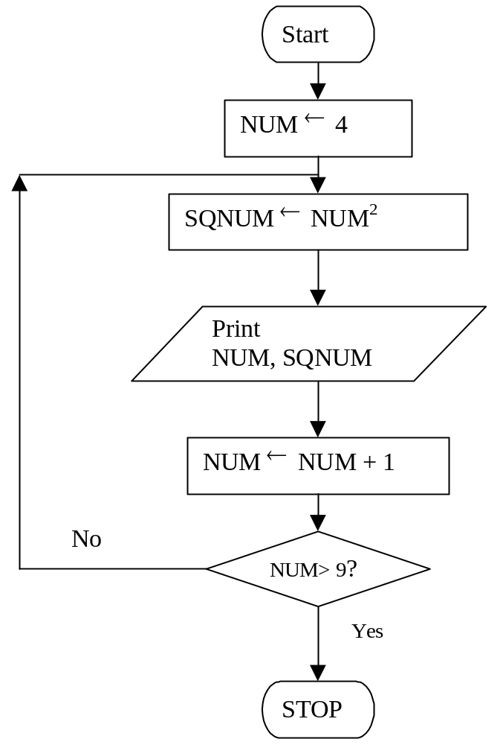
Example 5.1
Note:
NUM ← NUM + 1 means
old value of NUM + 1 becomes new value of NUM.
The algorithm can be described in pseudocode as follows:
NUM ← 4
do
SQNUM← NUM²
Print NUM, SQNUM
NUM ← NUM + 1
while (NUM <= 9)

Slide 14
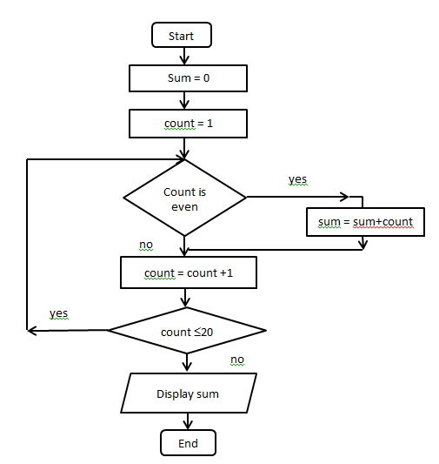
Example 5.2
The algorithm sums
all the even numbers between 1 and 20 inclusive and then displays then sum.
Programming Fundamentals

Slide 15
Pseudo-code of Example 5.2
sum = 0
count = 1
do
if count is even then
sum = sum + count
endif
count = count + 1
while count <= 20
Display sum

Slide 16
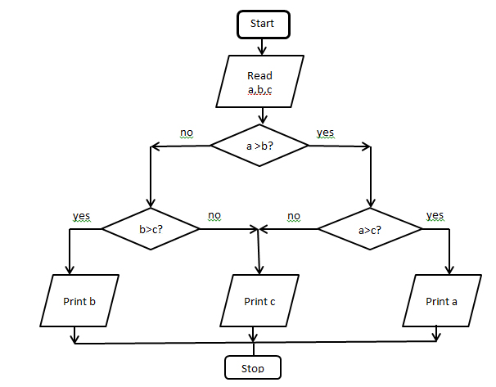
Exercise
Give the flowchart of the program which finds the largest among three different numbers. Write the pseudo-code for the flowchart.

Slide 17
Ans.
Input a,b,c
if a > b then
if a > c then
print a
endif
else
if b > c then
print b
else
print c
endif
endif

